Slide 1
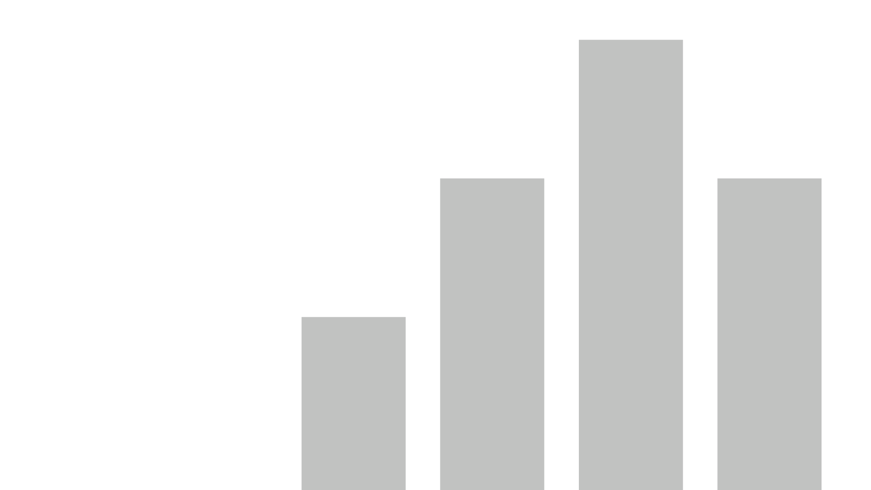


Shop Lifting Incidents in Albera,ontario and Manitoba
View in Power BI
Last data refresh:
1/1/2023 10:21:27 PM UTC
Downloaded at:
1/5/2023 12:14:33 AM UTC

Slide 2
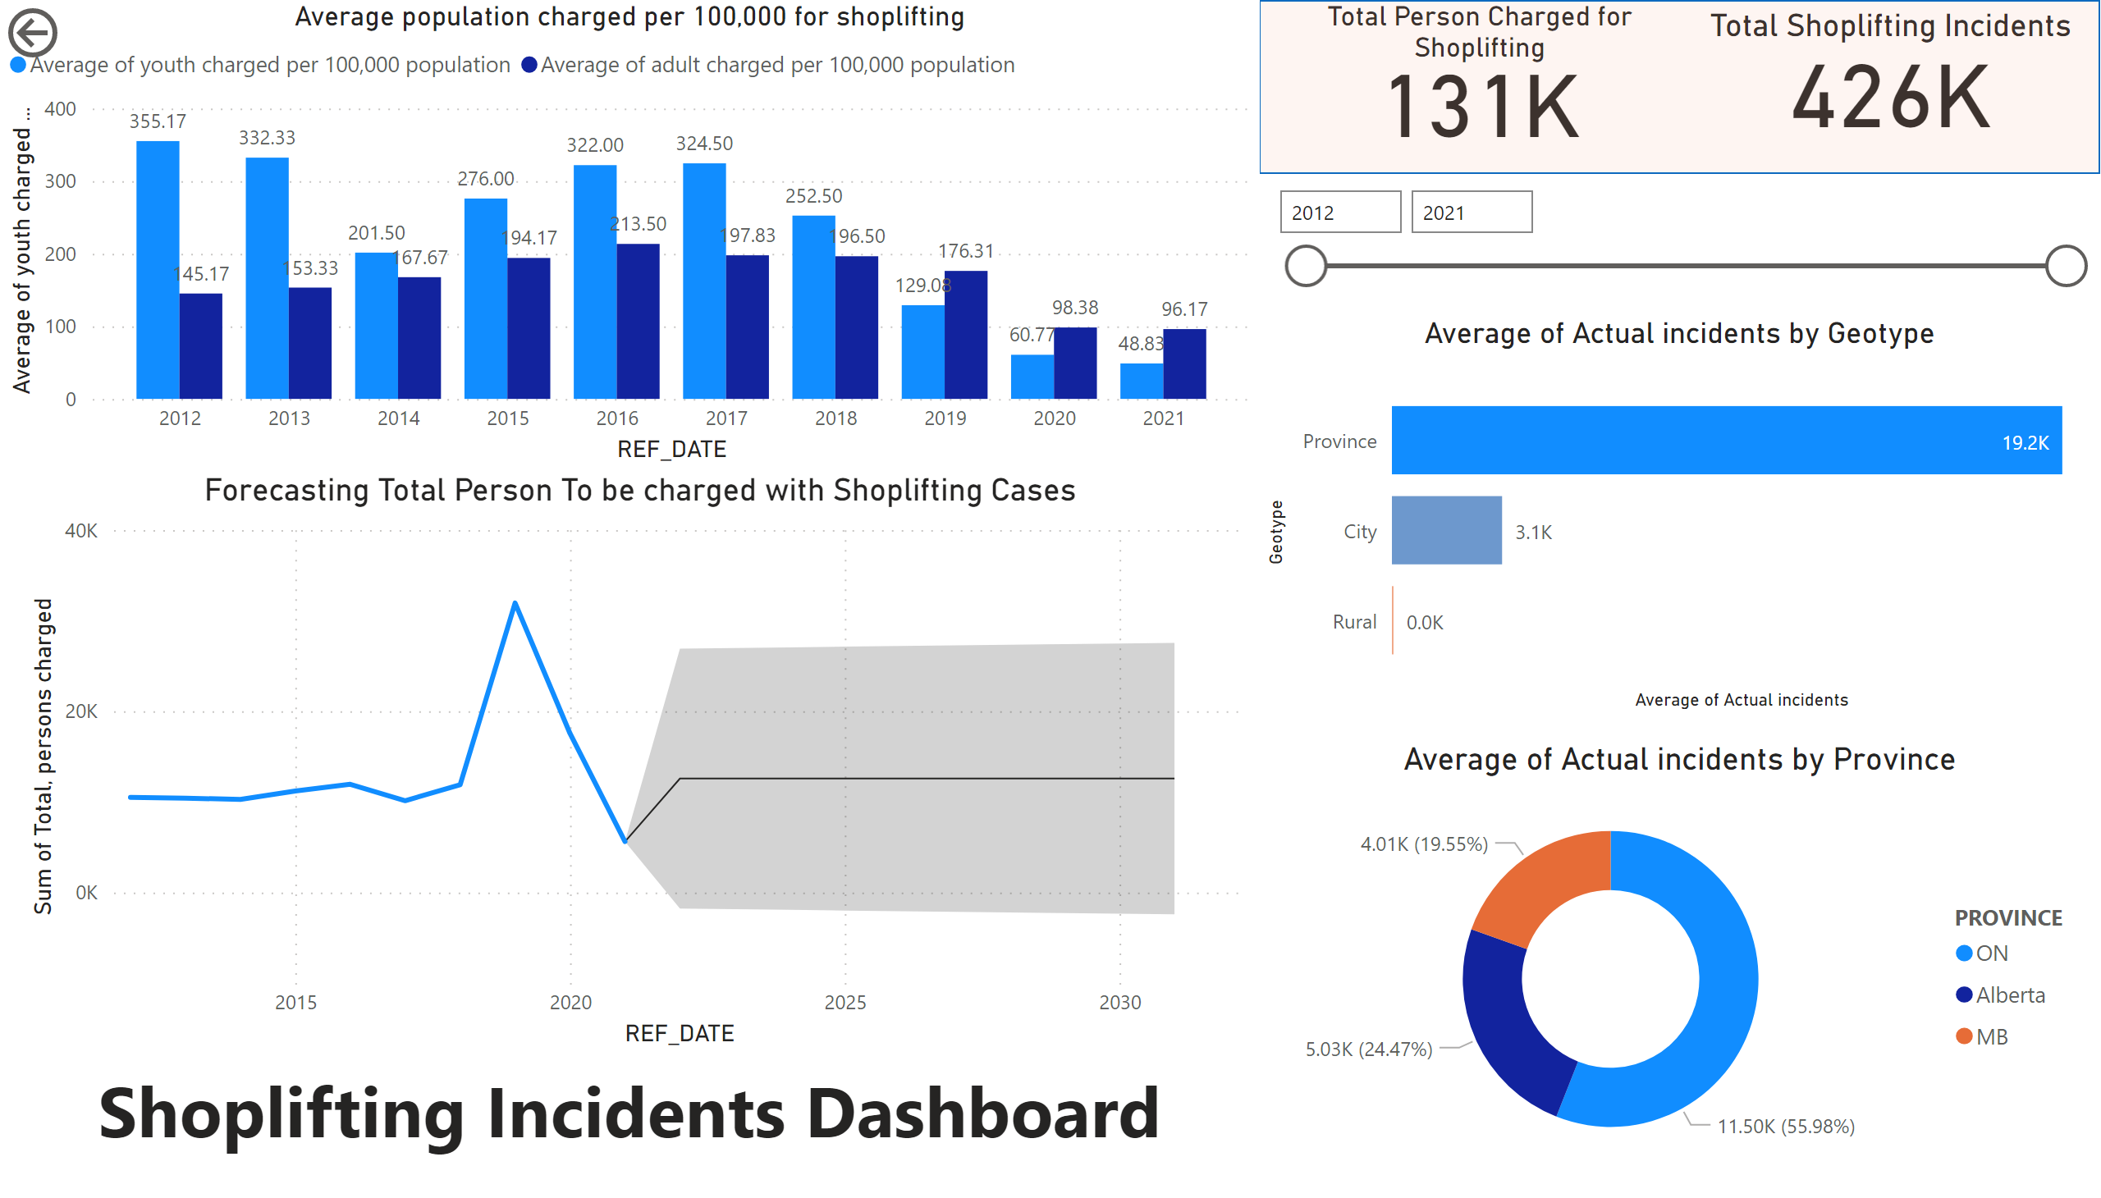
Page 1
Notes:
Total Person Charged for Shoplifting
No alt text provided
Total Shoplifting Incidents
No alt text provided
shape
No alt text provided
slicer
No alt text provided
Average population charged per 100,000 for shoplifting
No alt text provided
Average of Actual incidents by Province
No alt text provided
textbox
No alt text provided
actionButton
No alt text provided
barChart
No alt text provided
Forecasting Total Person To be charged with Shoplifting Cases
No alt text provided

